Slide 1
Teacher’s Identity
Md. Rukon Uddin
Asst. Teacher(English)
Gouripur R.K Govt. High School

Slide 2
Lesson Identity
Class-8
Subject- English 1st
Unit- Three
Health and hygiene

Slide 3

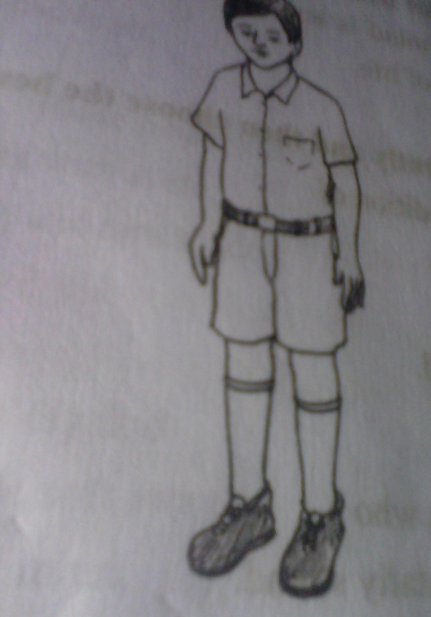
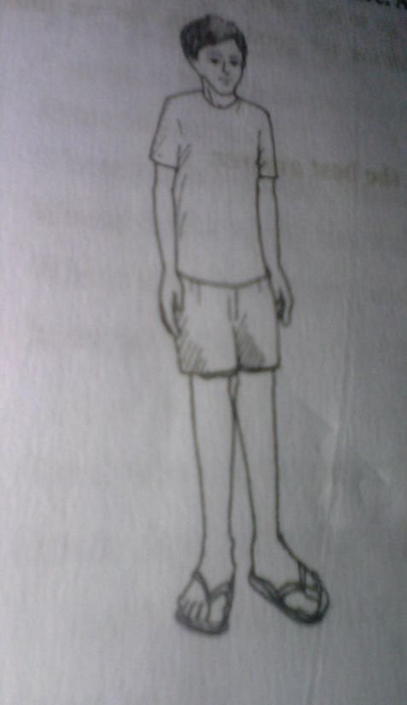
Topic
Health
Healthy couple
Healthy boy
Unhealthy boy

Slide 4
learning Outcomes
Ss will know about good health.
Ss will know about the importance of good health.
Ss will know about the importance of physical exercise.

Slide 5
presentation
Vocabulary
Disease- illness of the body or mind; রোগ
Essential – absolutely necessary. প্রয়োজনীয়
Concentrate- attention on something; মনোযোগ দেওয়া
Possession- the state of having; অধিকার
Which boy looks healthy?
Which boy is unhealthy?
Can you guess why they are so?

Slide 6
Health is the condition of our body and mind. Good health means healthy body free from diseases. If we are not in good health, we cannot concentrate on any activity in our life.
Health is wealth. We may have vast wealth and property, but if we are not healthy we cannot enjoy them.
To keep ourselves healthy, we have to eat a balanced diet. We must exercise regularly to keep our body fit for work.
Early to bed and early to rise makes a man healthy, wealthy and wise. We must not worry over small things of life.

Slide 7
Individual work
Who is a healthy person?
Why do we need to eat?
Why do we take balanced diet?

Slide 8
Group Work
Make a list of things that we have to do to keep our body fit.

Slide 9
Home work
Write a short paragraph on how to maintain good health.

Slide 10

Thanks to all

